Slide 1
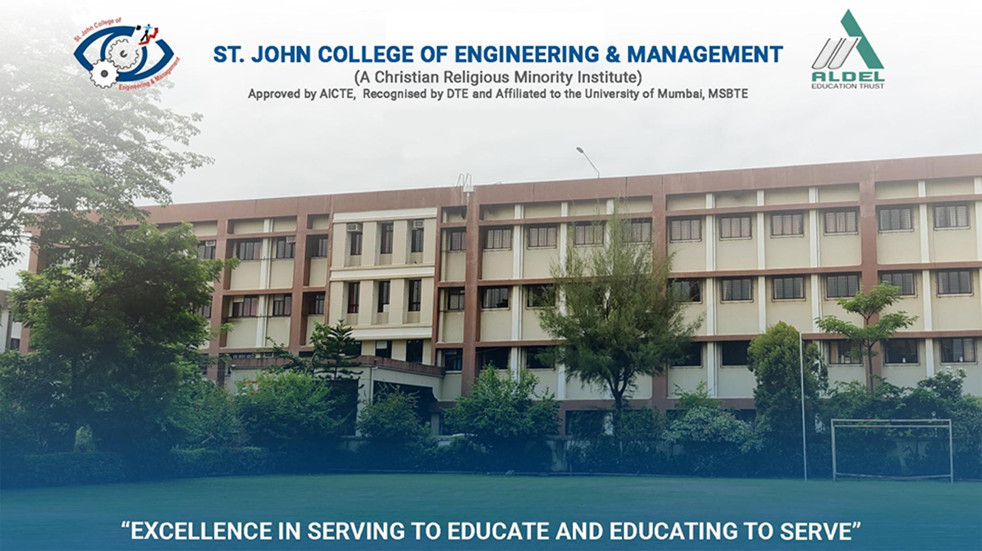
Department of Computer Science and Engineering (Data Science)
Welcomes
BOS Members
For
2nd BOS Meeting
Presented By
Dr. Sunny Sall
Assistant Professor & HOD
Computer Science and Engineering (Data Science)
Date: 12th November 2024
AUTONOMY AT SJCEM

Slide 2
AGENDA
To confirm Minutes of Meeting (MOM) of the last Board of Studies (BOS) meeting held on 11th June 2024
To review and discuss on Curriculum design, development, and Implementation w.r.t NEP 2020 and Autonomy requirements
Approval of scheme SJCEM : R-24 w.e.f. 2024-25 for Fourth Semester and Sixth Semester of B.Tech in Computer Science and Engineering (Data Science) Program
To discuss and review the Academic productivity in classroom and laboratory to meet the requirement of Outcome based Education
To discuss and review the Evaluation and Assessment methods and finalization for a panel of Examiners for theory and lab courses.
To review and discuss improvements required for effective teaching learning process, project quality, and semester conduct w.r.t reports received from Academic Performance Audit, NBA, and NAAC.

Slide 3
INTRODUCTION
Department Vision
To be a department committed to develop capable and efficient Computer Science and Engineering (Data Science) graduates with an aptitude for research and leadership qualities
Department Mission
To inculcate habit of life long learning to become globally competent Computer Science and Engineering (Data Science) graduates.
To promote excellence by encouraging creativity, critical thinking and discipline.
To establish relationships with other institutes as well as industries to have collaborative learning.

Slide 4
Program Educational Objectives (PEOs)
● To attain knowledge, skills, and competencies for futuristic needs required at national and international levels with ethical standards.
● To contribute to the development of Computer Science and Engineering (Data Science) through research.
● To display personal growth by pursuing higher studies, professional development courses, and/or engineering certification.
Program Specific Outcomes (PSOs)
Graduate will be able to design and analyze mechanical components and systems as per given specification using data books and software.
Graduate will be able to specify and design the thermal system including heat exchangers, condensers, evaporators, air conditioners, refrigeration system, compressor, pumps, turbines, etc. as per given specifications
Graduate will be able to plan, including methods design, process plan, process automation, and quality assurance system for manufacturing of given mechanical components and system.

Slide 5
Program Outcomes (POs)
1. Graduates will be able to apply the basic knowledge in mathematics, sciences and engineering fundamentals for solving problems in mechanical engineering.
2. Graduates will be able to apply knowledge, techniques and skills to design mechanical and thermal systems or process as per requirements
3. Graduates will be able to able to demonstrate the ability to design and conduct experiments and standard tests to interpret and analyze data and results.
4. Graduates will be able to identify, formulate and design complex mechanical engineering problem in their future profession.
5. Graduates will be able to select and use modern engineering software tools and equipment to analyze mechanical engineering problems
6. Graduates will be able to appreciate social and cultural values, assess the health, safety and legal issues and practices.
7.Graduates will be able to understand the impact of professional engineering solution for sustainable development.
8. Graduates will be able to understand the professional as well as ethical responsibilities and norms of different countries.
9. Graduates will be able to function effectively within multidisciplinary team as a leader or member.
10. Graduates will be able to communicate effectively within engineering community and society by means of report writing, presentation and documentation.
11. Graduates will able to demonstrate knowledge and understanding of engineering and management
12. Graduates will be able to understand clearly and implement the values of lifelong learning

Slide 6
BOS MEMBERS
Sr. No. | Designation in Committee | Member Names
01 | Chairman | Dr. Sunny Sall
02 | All faculty members of the Department | Ms. Praniti Patil Mr. Adil Shaikh
03 | Subject Expert 01 [Outside the parent University are to be nominated by the Academic Council] | Dr. Saumya Y. M. Associate Prof., St Joseph Engineering College, Mangalore, Karnataka
04 | Subject Expert 02 [Outside the parent University are to be nominated by the Academic Council] | Dr. Rashmi Deshmukh Associate Prof., DOT, Shivaji University, Kolhapur, Maharashtra
05 | Expert 01 [Nominated by the Vice-Chancellor from a panel of six recommended] | Dr. Bhavesh Patel Principal, Shah and Anchor Kutchchi Engineering College, Mumbai, Maharashtra

Slide 7
BOS MEMBERS
Sr. No. | Designation in Committee | Member Names
06 | Industry/corporate sector/allied areas to be nominated by the Principal. | Mr. Himanshu Singh Vice President, J. P. Morgan Chase, Mumbai, Maharashtra
07 | Alumni Member [Nominated by the Principal] | Mr. Hiren Anand Software Quality Analyst, eClinical Works, Ahmedabad, Gujrat
08 | Experts from outside the Autonomous College [Nominated by the Principal] | Dr. Terence K. Johnson Associate Dean, Mangalore Institute of Technology, Mangalore, Karnataka
09 | Special Invitee | Dr. Rupa Mehta Former HoD Computer Engineering, SVNIT, Surat, Gujrat

Slide 8
Agenda: 1/6
To confirm Minutes of Meeting (MOM) of the last Board of Studies (BOS) meeting held on 11th June 2024
MOM
ACTION _TAKEN_REPORT

Slide 9
Agenda: 2/6
To review and discuss on Curriculum design, development, and Implementation w.r.t NEP 2020 and Autonomy requirements

Slide 10
SCHEMES
Sr. No. | Scheme | Particulars | Commencement | Total Credits | Remark
1. | SJCEM : R-24 | SE | SE: 2024-25 TE: 2025-26 BE: 2026-27 | 172 | As per NEP 2020 guidelines
2. |  | TE | TE: 2024-25 BE: 2025-26 | 172 | -

Slide 11
Agenda: 3/6
Approval of scheme SJCEM : R-24 w.e.f. 2024-25 for Fourth Semester, Sixth Semester of B.Tech in Computer Science and Engineering (Data Science) Program

Slide 12
SCHEME FOR COMPUTER SCIENCE AND ENGINEERING (DATA SCIENCE)
SEM III A.Y. 2024-25 (FOR REFERENCE)
Scheme for Computer Science and Engineering (Data Science) Sem III (SJCEM R 24)
Course Code | Vertical | Course Name | Contact Hrs |  |  | Credit Allotted |  |  | Total Credits | Evaluation Scheme
 |  |  |  |  |  |  |  |  |  | IAE 1 | IAE 2 | ESE | CA (TW) | OR/PR | Total
 |  |  | Th | Tut | Pr | Th | Tut | Pr
24CSDSPCC301 | PCC | Discrete Mathematics | 3 | 1 | - | 3 | 1 | - | 4 | 20 | 20 | 60 | 25 | - | 125
24CSDSPCC302 | PCC | Data Structures | 2 | - | 4 | 2 | - | 2 | 4 | 20 | 20 | 60 | 25 | 25 | 150
24CSDSPCC303 | PCC | Microprocessor and Computer Architecture | 3 | - | 2 | 3 | - | 1 | 4 | 20 | 20 | 60 | 25 | - | 125
24CSDSPCC304 | PCC | Database Management System | 2 | - | 2 | 2 | - | 1 | 3 | 20 | 20 | 60 | 25 | 25 | 150
24CSDSPCC305 | PCC | Programming Language I (C++/Java) | 1 | - | 4 | 1 | - | 2 | 3 | 10 | 10 | 30 | 50 | 25 | 125
24CSDSVEC301 | VEC | Universal Human Values -2 | 2 | 1 | - | 2 | 1 | - | 3 | 10 | 10 | 30 | 25 | - | 75
24CSDSAEC301 | AEC | Employability Enhancement Program – 2 (Communication) | 1 | - | - | 1 | - | - | 1 | - | - | - | 25 | - | 25
 |  | Total | 14 | 2 | 12 | 14 | 2 | 6 | 22 | 100 | 100 | 300 | 200 | 75 | 775

Slide 13
SCHEME FOR COMPUTER SCIENCE AND ENGINEERING (DATA SCIENCE)
SEM IV A.Y. 2024-25
Scheme for Computer Science and Engineering (Data Science) Sem IV (SJCEM R 24)
Course Code | Vertical | Course Name | Contact Hrs |  |  | Credit Allotted |  |  | Total Credits | Evaluation Scheme
 |  |  |  |  |  |  |  |  |  | IAE 1 | IAE 2 | ESE | CA (TW) | OR/PR | Total
 |  |  | Th | Tut | Pr | Th | Tut | Pr
24CSDSPCC401 | PCC | Statistics and Probability | 3 | - | - | 3 | - | - | 3 | 20 | 20 | 60 | 25 | - | 125
24CSDSPCC402 | PCC | Analysis of Algorithm | 3 | - | 2 | 3 | - | 1 | 4 | 20 | 20 | 60 | 25 | 25 | 150
24CSDSPCC403 | PCC | Computer Networks | 3 | - | 2 | 3 | - | 1 | 4 | 20 | 20 | 60 | 25 | - | 125
24CSDSPCC404 | PCC | Operating System | 2 | - | 2 | 2 | - | 1 | 3 | 20 | 20 | 60 | 25 | - | 125
24CSDSPCC405 | PCC | Programming Language II (Python) | 1 | - | 4 | 1 | - | 2 | 3 | 10 | 10 | 30 | 50 | - | 100
24CSDSAEC401 | AEC | Employability Enhancement Program – 3 (Communication) | - | - | 2 | - | - | 1 | 1 | - | - | - | 25 | - | 25
24CSDSVSE401 | VSEC | Employability Enhancement Program – 4 (Technical) | 1 | - | 2 | 1 | - | 1 | 2 | 10 | 10 | 30 | 25 | - | 75
24CSDSOJT401 | OJT | Internship I | - | - | 2 | - | - | 2 | 2 | - | - | - | - | 50 | 50
 |  | Total | 13 | 0 | 16 | 13 | 0 | 9 | 22 | 100 | 100 | 300 | 200 | 75 | 775

Slide 14
SCHEME FOR COMPUTER SCIENCE AND ENGINEERING (DATA SCIENCE)
SEM V SJCEM RO 24 (FOR REFERENCE)
Course Code | Vertical | Course Name | Contact Hrs |  |  | Credit Allotted |  |  | Total Credits | Evaluation Scheme
 |  |  |  |  |  |  |  |  |  | IAE 1 | IAE 2 | ESE | CA (TW) | OR/PR | Total
 |  |  | Th | Tut | Pr | Th | Tut | Pr
24CSDSPCC501 | PCC | Computer Network | 3 | - | - | 3 | - | - | 3 | 20 | 20 | 60 | 25 | - | 125
24CSDSPCC502 | PCC | Web Computing | 3 | - | 2 | 3 | - | 1 | 4 | 20 | 20 | 60 | 25 | 25 | 150
24CSDSPCC503 | PCC | Artificial Intelligence | 3 | - | 2 | 3 | - | 1 | 4 | 20 | 20 | 60 | 25 | 25 | 150
24CSDSPCC504 | PCC | Data Warehousing & Mining | 3 | - | 2 | 3 | - | 1 | 4 | 20 | 20 | 60 | 25 | 25 | 150
24CSDSDLO501X | PCE | Department Level Optional Course 1 | 3 | - | - | 3 | - | - | 3 | 20 | 20 | 60 | - | - | 100
24CSDSVSEC501 | VSEC | Employability Enhancement Program – 5 (EEP – 5) | - | - | 6 | - | - | 3 | 3 | - | - | - | 50 | - | 50
24CSDSVSEC501 | VSEC | Skill Based Lab with Mini Project | - | - | 2 | - | - | 1 | 1 | - | - | - | 25 | 25 | 50
 |  | Total | 15 | 0 | 8 | 15 | 0 | 7 | 22 | 100 | 100 | 300 | 175 | 100 | 775

Slide 15
SCHEME FOR COMPUTER SCIENCE AND ENGINEERING (DATA SCIENCE)
SEM V SJCEM RO 24 (FOR REFERENCE)
DLOC | Code | Course
DLOC 1 | 24CSDSDLO5011 | Probabilistic Graphical Models
 | 24CSDSDLO5012 | Internet Programming
 | 24CSDSDLO5013 | Advance Database Management System

Slide 16
SCHEME FOR COMPUTER SCIENCE AND ENGINEERING (DATA SCIENCE)
SEM VI SJCEM RO 24
Course Code | Vertical | Course Name | Contact Hrs |  |  | Credit Allotted |  |  | Total Credits | Evaluation Scheme
 |  |  | Th | Tut | Pr | Th | Tut | Pr |  | IAE 1 | IAE 2 | ESE | CA (TW) | OR/PR | Total
24CSDSPCC601 | PCC | Data Analytics and Visualization | 3 | - | 2 | 3 | - | 1 | 4 | 20 | 20 | 60 | 25 | 25 | 150
24CSDSPCC602 | PCC | Cryptography and System Security | 3 | - | 2 | 3 | - | 1 | 4 | 20 | 20 | 60 | 25 | - | 125
24CSDSPCC603 | PCC | Software Engineering and Project Management | 3 | - | 2 | 3 | - | 1 | 4 | 20 | 20 | 60 | 25 | - | 125
24CSDSPCC604 | PCC | Machine Learning | 3 | - | 2 | 3 | - | 1 | 4 | 20 | 20 | 60 | 25 | 25 | 150
24CSDSPEC601X | PCE | Department Level Optional Course 2 | 3 | - | - | 3 | - | - | 3 | 20 | 20 | 60 | - | - | 100
24CSDSVSEC601 | VSEC | Employability Enhancement Program (Technical) | - | - | 4 | - | - | 2 | 2 | - | - | - | 50 | - | 50
24CSDSVSE602 | VSEC | Industry Certification | - | - | - | - | - | 1 | 1 | - | - | - | - | 25 | 25
24CSDSOJT601 | OJT | Internship II | - | - | - | - | - | 1 | 1 | - | - | - | - | 50 | 50
 |  | Total | 15 | 0 | 12 | 15 | 0 | 8 | 23 | 100 | 100 | 300 | 150 | 125 | 775

Slide 17
SCHEME FOR COMPUTER SCIENCE AND ENGINEERING (DATA SCIENCE)
SEM - VI SJCEM RO 24
DLOC | Code | Course
DLOC 2 | 24CSDSPEC6011 | High Performance Computing
 | 24CSDSPEC6012 | Distributed Computing
 | 24CSDSPEC6013 | Image &amp; Video Processing

Slide 18
Syllabus_Booklet
BOS, COMPUTER SCIENCE AND ENGINEERING (DATA SCIENCE), SJCEM

Slide 19
Agenda: 4/6
To discuss and review the Academic productivity in classroom and laboratory to meet the requirement of Outcome based Education

Slide 20

Departmental Activities | Glimpses (Inauguration of OADS)

Slide 21
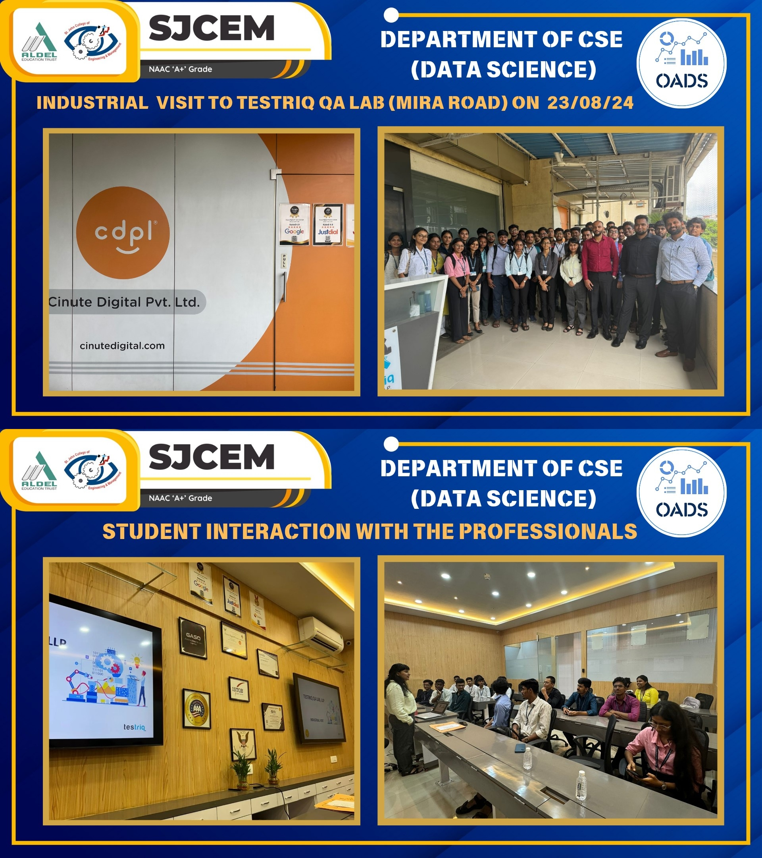
Departmental Activities | Glimpses (IV at Mira Road)

Slide 22
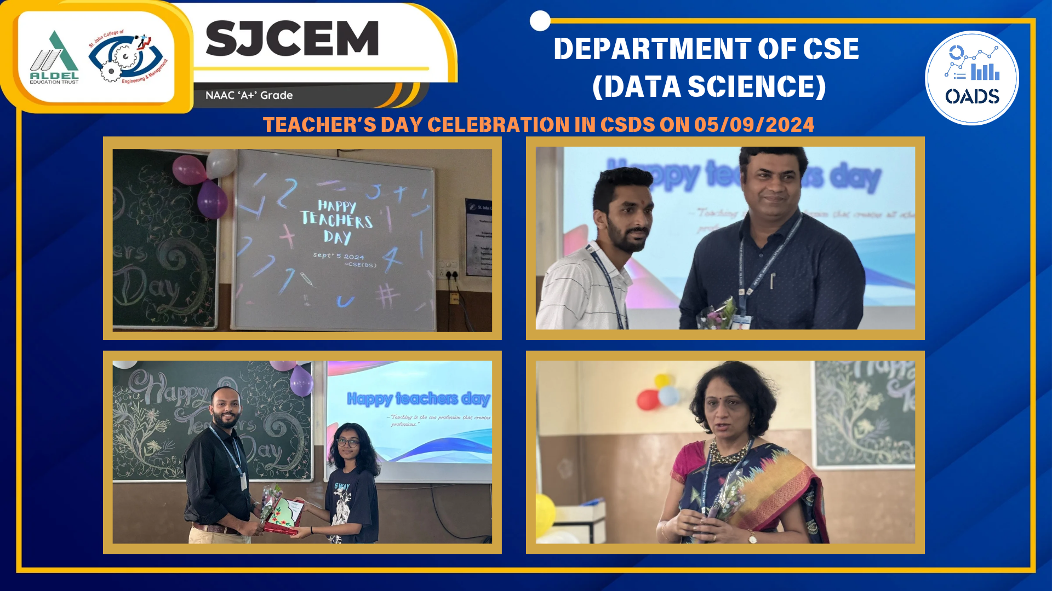
Departmental Activities | Glimpses (Teachers Day Celebration)

Slide 23
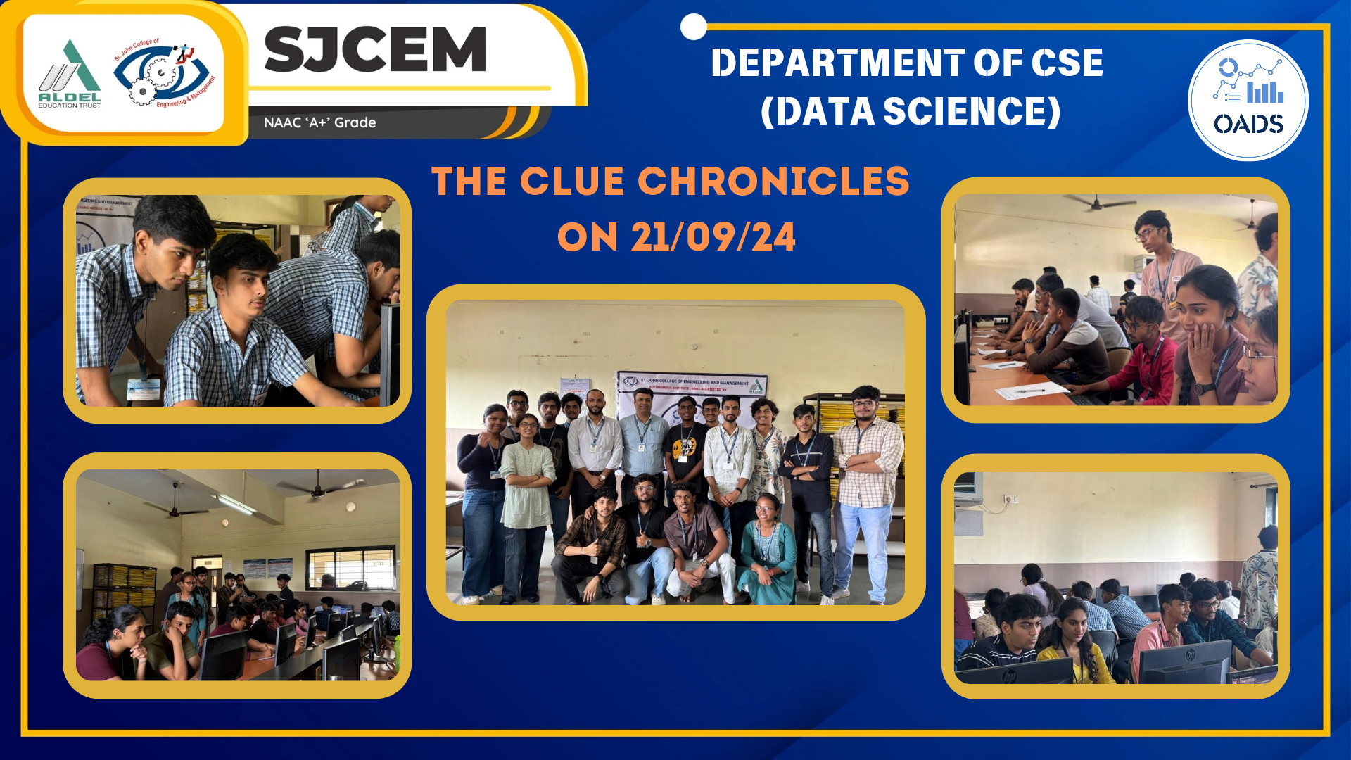
Departmental Activities | Glimpses (Quiz Competition)

Slide 24
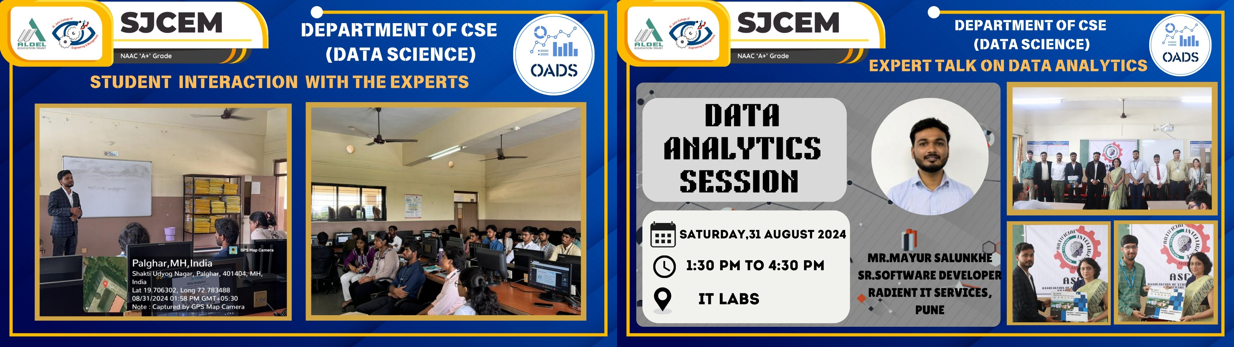
Departmental Activities | Glimpses (Experts Talk - Data Analytics)

Slide 25
Agenda: 5/6
To discuss and review the Evaluation and Assessment methods and finalization for a panel of Examiners for theory and lab courses.
List of Teacher Assessment Examination (TAE):
Assignment
Case Study
Debate
Solution for Social Problems
Field Visit
Group Project
Flip Classroom
Topic Review
Quiz
Mind Mapping
Any other
Note: Number of activities to be conducted under TAE would be as per the subject need.
Theory Passing Marks (IAE / ESE) Passing Criteria : 40%
Continuous Assessment (CA) / Oral / Practical Passing Criteria : 50%
Internal Assessment Examination (IAE):
Assessment consists of two class tests, each 20 marks. The IAE 1 will cover any three Course Outcomes (COs) and IAE 2 will cover the remaining three Course Outcomes (COs). Each test will have a duration of one hour.
End Semester Theory Examination (ESE):
End Semester exam of 60 Marks will be conducted based on entire syllabus.
Continuous Assessment (CA) :
Continuous Assessment should consist of the following
Experiments / Tutorials (8 to 10): 10 marks (All COs / LOs should be covered)
Attendance (Theory & Practical): 05 marks
Teacher Assessment Examination (TAE): 10 Marks
Oral & Practical Exam
Based on the entire syllabus, oral (10 marks) & practical/implementation (15 marks) examination will be conducted.

Slide 26
Agenda: 6/6
To review and discuss improvements required for effective teaching learning process, project quality, and semester conduct w.r.t reports received from Academic Performance Audit, NBA, and NAAC.

Slide 27
Feedback on Syllabus by the stakeholders
Subjects/ Academic Related:
To provide training for Faculties as and when required.
Instead of offering various Tracks offer Honor/ Minor courses, Give double Honor/ Minor to eligible students.
A lot of theory subject and their exams and term work will consume a lot of time of students and faculty, emphasis more on practical’s and allow online or soft copy submissions if possible.
Pedagogy Related:
Opportunities for internships shall be given to the students.
Multidisciplinary Projects shall be encouraged.
Number of Industrial visits may be increased.
Exam/ Evaluation Related:
How will you evaluate internship, Rubrics must be clarified.
List of Courses that can be taken as MOOC shall be known in advance.
To keep a Specific name of subjects like EEP, CCES etc.
BOS, COMPUTER SCIENCE AND ENGINEERING (DATA SCIENCE), SJCEM

Slide 28


